Slide 1
Fundamentals of Big Data Analytics
Lecture 2-Hadoop Distributed File System

Slide 2
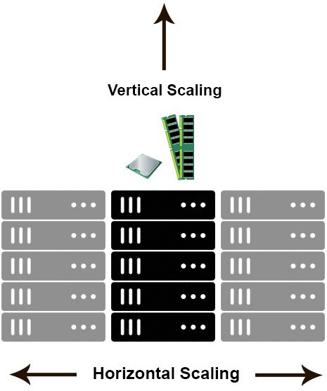
Vertical Scaling Vs. Horizontal Scaling?
•Horizontal scaling means that you scale by adding more machines into your pool of resources
•Vertical scaling means that you scale by adding more power (CPU, RAM) to an existing machine.

Slide 3





Big Data Platforms

Slide 4

Big Data Platforms
•Hadoop
•HDFS (Hadoop Distributed File System) –storage unit
•Map-reduce -processing unit
•Spark
•RDD

Slide 5
What is Hadoop?
Apache Hadoop is an open source software framework for storage and large scale processing of data-sets.

Slide 6
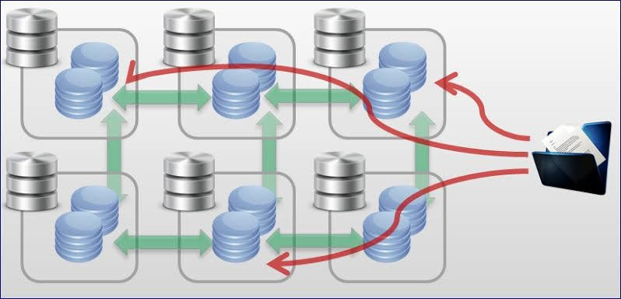
Moving Computation to Data
DATA
Source: UC San Diego, Big Data

Slide 7
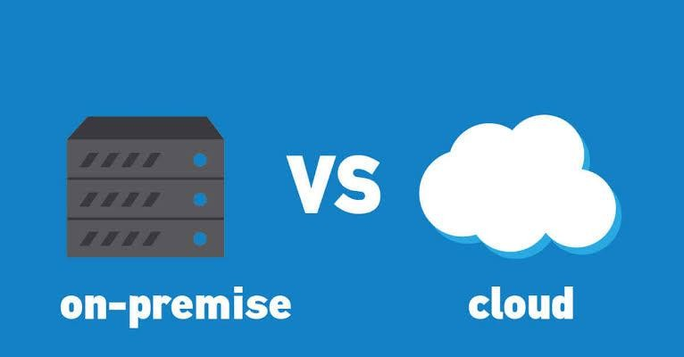

Slide 8
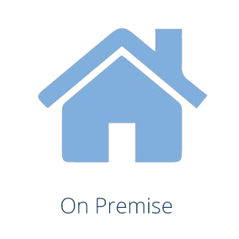
On Premises
• Software and technology
• located within the physical confines of an enterprise
• Often in the company's data centers – as opposed to running remotely on
hosted servers or in the cloud.

Slide 9
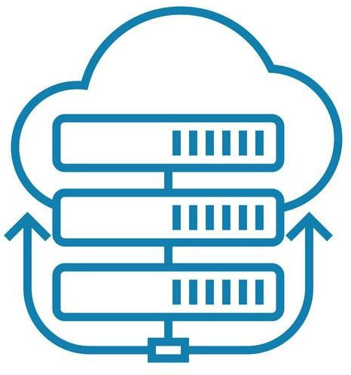
Cloud Computing
• Differs from on-premises software in one critical way.
• Third-party provider hosts all that for you.
• Allows companies to pay on an as-needed basis.
• Allows companies to effectively scale up or down depending on overall usage, user requirements, and the growth of a company.

Slide 10
HDFS
Hadoop Distributed File System
Distributed, scalable, and portable file- system written in Java for the Hadoop framework

Slide 11
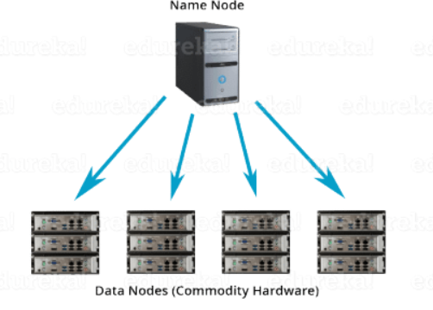
HDFS
block-structured file system where each file is divided into blocks of a pre-determined size.
stored across a cluster of one or several machines.
Follows master-slave architechure
cluster comprises of a single NameNode (Master node) and all the other nodes are DataNodes (Slave nodes).

Slide 12
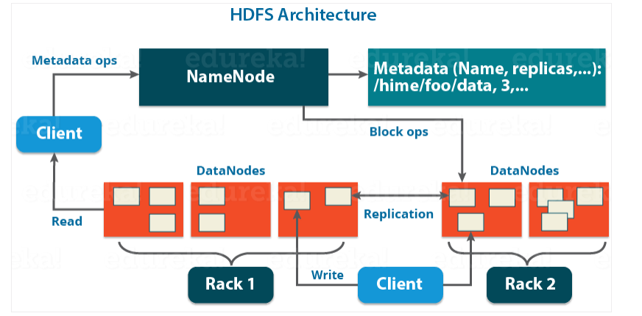
NameNode
Master Node- manages blocks present on the DataNodes (slave nodes).
user data never resides on the NameNode. The data resides on DataNodes only

Slide 13
NameNode
Master Node- manages blocks present on the DataNodes (slave nodes).
user data never resides on the NameNode. The data resides on DataNodes only

Slide 14
NameNode
records the metadata of all the files stored in the cluster, e.g. The location of blocks stored, the size of the files, permissions, hierarchy, etc.
records each change that takes place to the file system metadata. For example, if a file is deleted in HDFS, the NameNode will immediately record this in the EditLog
record of all the blocks in HDFS and in which nodes these blocks are located.
responsible to take care of the replication factor

Slide 15
DataNode
Slave nodes in HDFS
Commodity hardware, that is, a non-expensive system which is not of high quality or high-availability.
Process runs on each slave machine.
Actual data is stored on DataNodes
Perform the low-level read and write requests from the file system’s clients

Slide 16
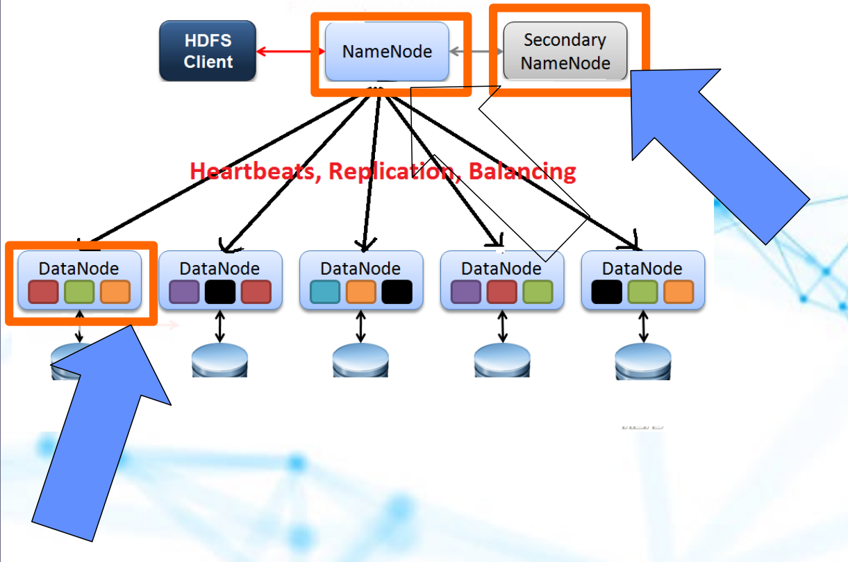
DataNode

